Slide 1


The A Team:
David Evans
Adam Driscoll
Josh Bennett
Joe Phaneuf
Henry Chen
GROUNDSBOT
The golf course mowing robot
Sponsor:
Notes:
Good afternoon!
We are Team A...But you can call us the A-Team
Our team members are David Evans, Adam Driscoll, Henry Chen, Josh Bennett, and myself, Joe Phaneuf
Our gracious and steadfast sponsor is Discovery Robotics
Today we're going to introduce you to the future of autonomous grounds maintenance....
This. Is. GroundsBot!

Slide 2
Functional Requirements
GroundsBot shall:
ID | Requirement
F.R.1 | Accept boundaries from user
F.R.2 | Cut the rough at desired quality
F.R.3 | Avoid obstacles
F.R.4 | Climb hills
F.R.5 | Return to home

Slide 3
Performance Requirements
GroundsBot will:
ID | Requirement
M.P.1 | First time user inputs map within 15 minutes
M.P.2 | System returns proposed route/coverage map within 5 minutes
M.P.3 | Cover 1/8 acre in 30 minutes on flat, unobstructed terrain
M.P.4 | Cut 0-25% overlap for 95% of grass
M.P.5 | Navigate 30 degree sloped grass
M.P.6 | Detect 80% of static objects greater than 3 inches in height and 2 inches in width
M.P.7 | Detect 80% of dynamic objects greater than 6 inches in height and 6 inches in width travelling less than 4 mph
M.P.8 | Mow to within 1 foot of detected obstacles
M.P.9 | Return home to within 5 feet of starting position
Notes:
Adam
Removed height requirement
Substantially reduced coverage area
Specified object detection rate and static vs dynamic
Removed feedback
M.P.4 – A complicated way of saying we’re going to zig-zag efficiently. If you think about the task of lawn mowing, you want some overlap to ensure you’re not missing any spots. But too much overlap and you’re being inefficient. So these numbers are trying to ensure we don’t miss anything but are still being efficient.

Slide 4
Non-functional Requirements
GroundsBot will:
ID | Requirement
M.N.1 | Have a functional and easily accessible emergency stop
M.N.2 | Be clearly visible
M.N.3 | Not tear up grass
Notes:
Adam
In our first attempt we approached it as GroundsBot the startup company. We’ve realized, while an educational experience, a lot of the NFRs we came up with weren’t relevant within the scope of the school project.
Pretty much all of the old ones are gone and these are the new ones.
Needs to be safe – don’t want to chop off limbs
Needs to be visible for safety as well
Needs to keep the grass in tact.

Slide 5
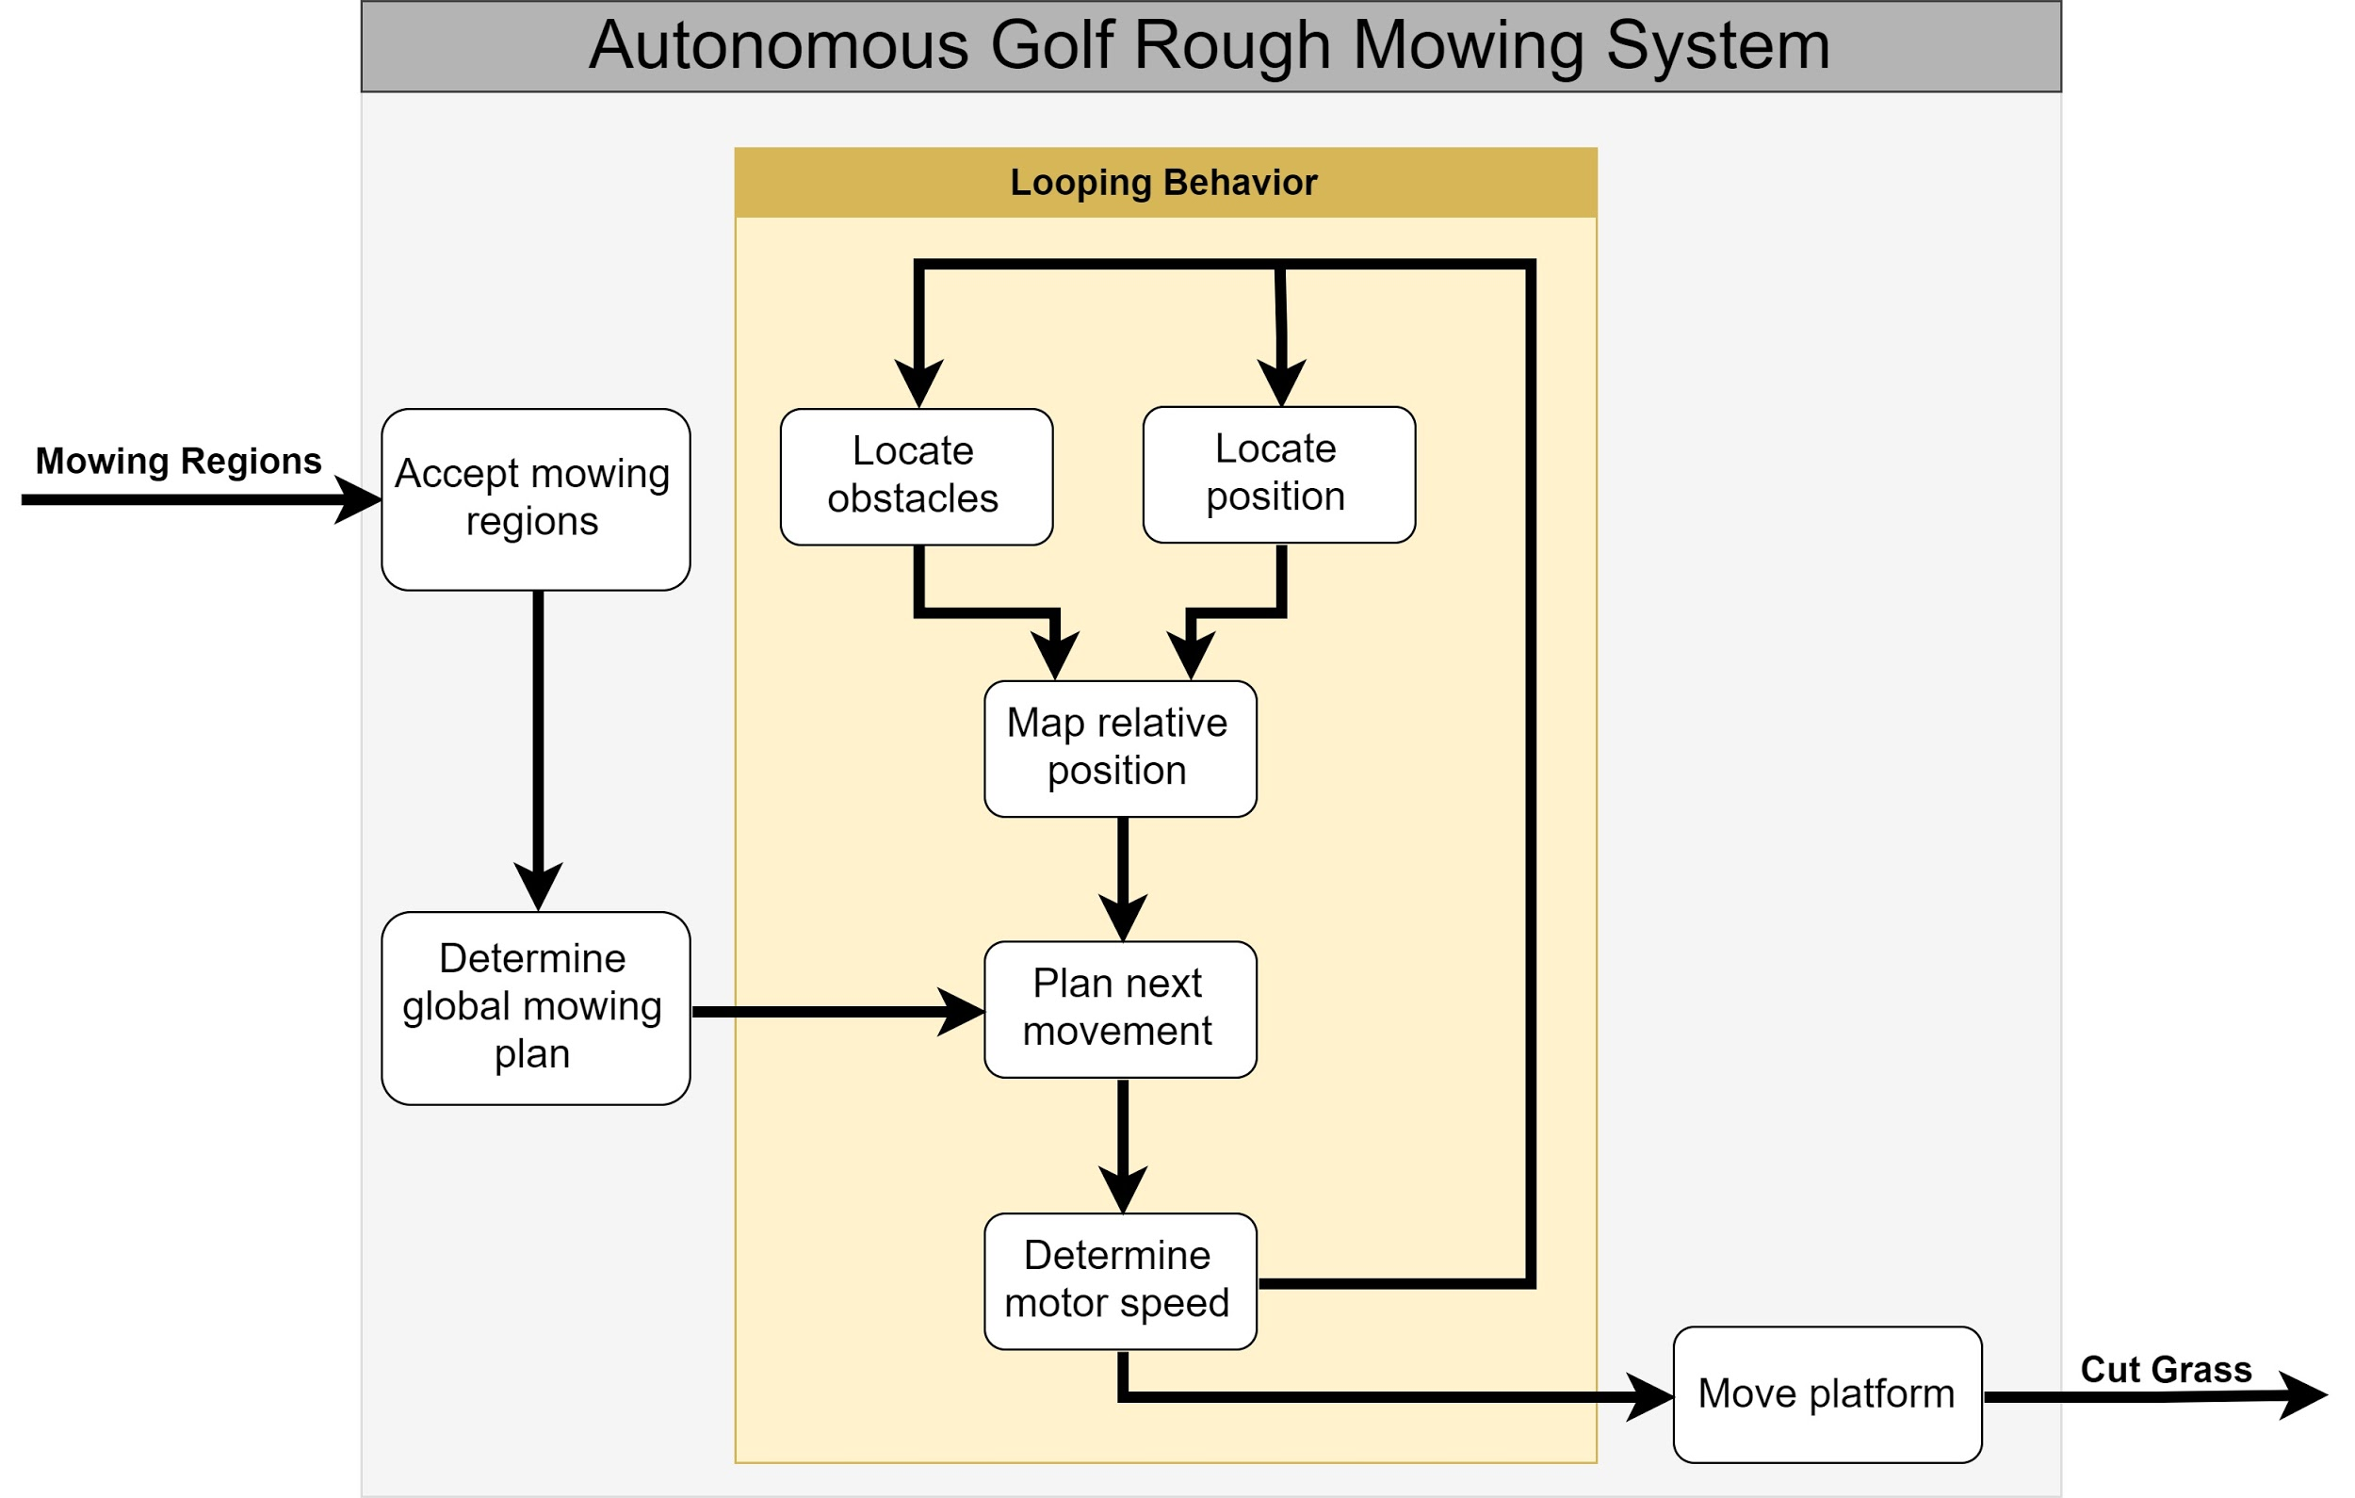
Functional Architecture
Notes:
Josh

Slide 6
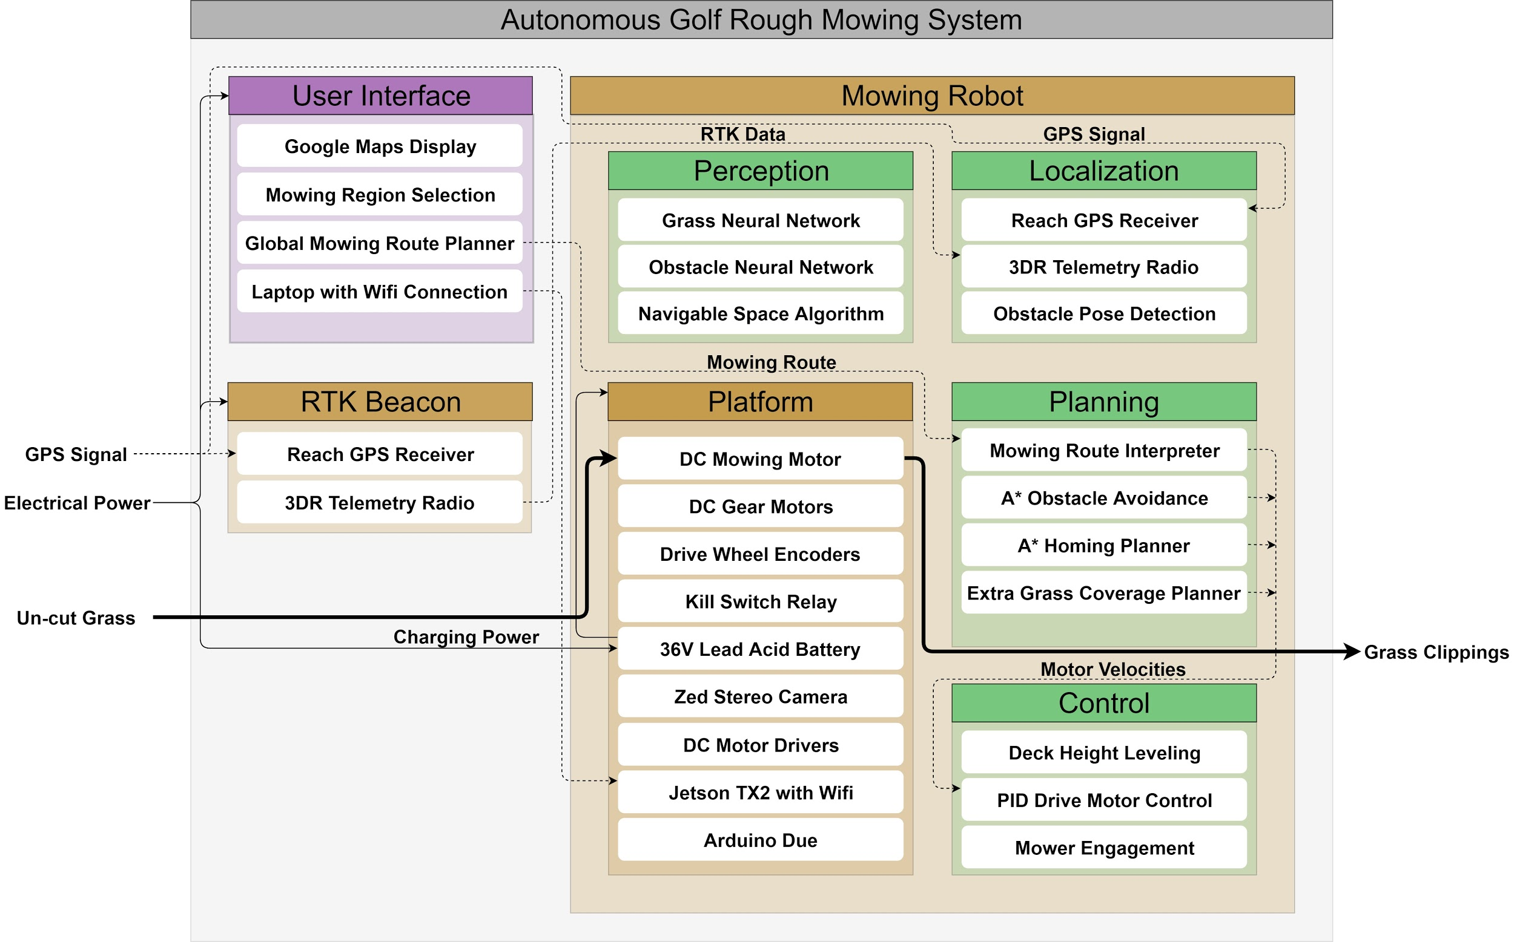
Cyber-physical Architecture
Notes:
Josh

Slide 7
SVE WBS
UI | Platform | Localization | Perception
App | Electronics | Global localization | Grass (type) detection
 | Chassis | Obstacle localization | Static obstacle detection
 | Firmware |  | Dynamic obstacle detection
Planning | Mapping | Control | Management
Mission Planner | Obstacle mapping | Motor control | Schedule
Local motion Planner | Boundary correction |  | Finance
 |  |  | Risk
 |  |  | Personnel
Notes:
Joe

Slide 8
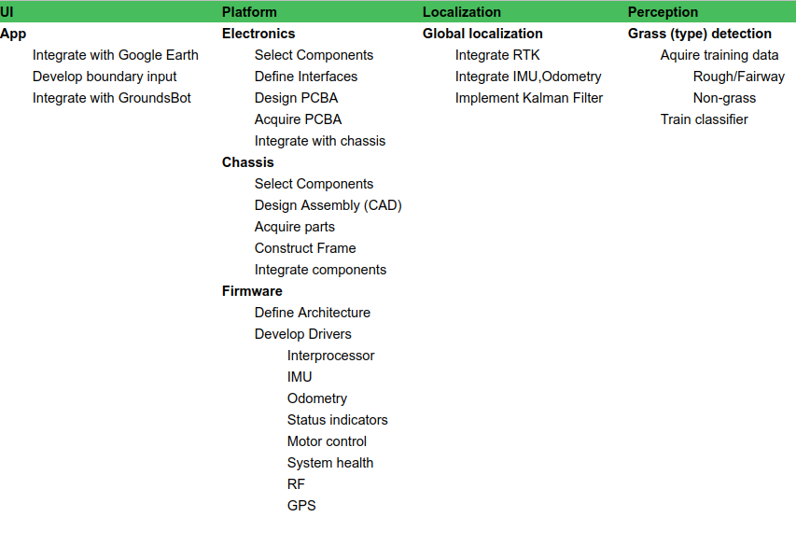
FVE WBS Part 1
Notes:
Joe

Slide 9
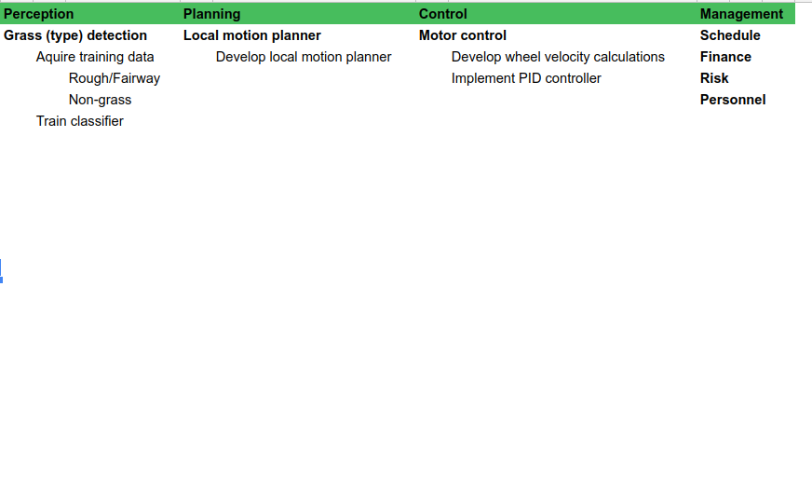
FVE WBS Part 2
Notes:
Joe

Slide 10
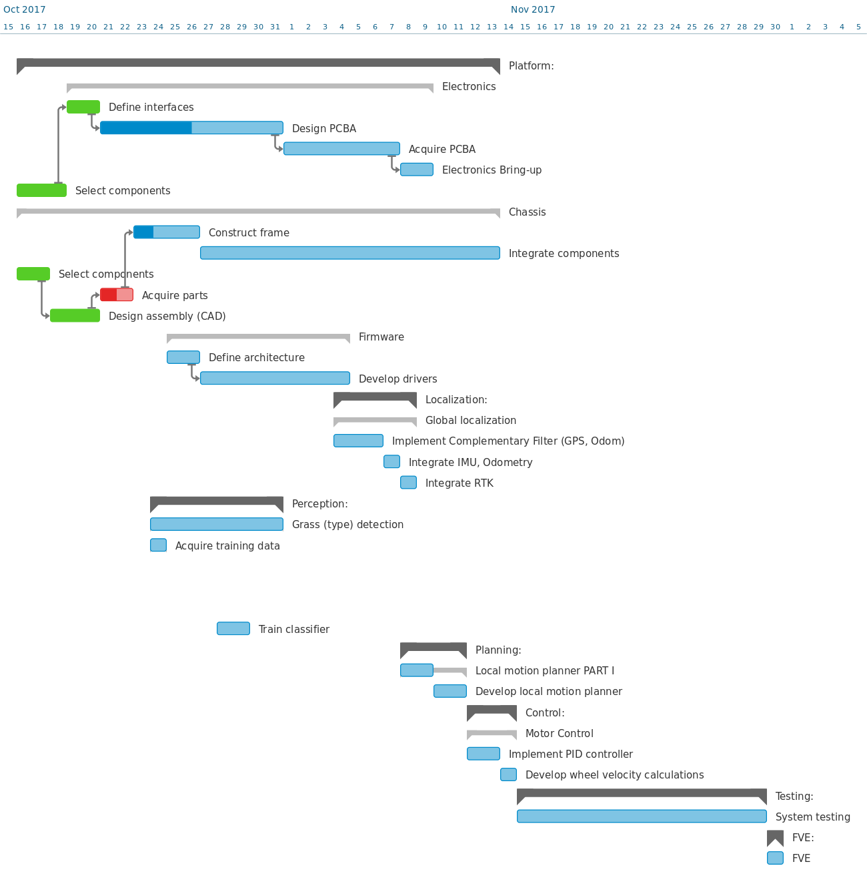
Schedule
Notes:
Joe

Slide 11
Risks
Risk | Description | Management Strategy | Risk Category
Not Enough Capital for Development: | There is a risk our system requires more money than initially allocated. | Maintain strong relationship with sponsor Reach out to other sponsors or donors Strictly monitor budgeted plan | Schedule
Injury from Spinning Blade: | Our system has a dangerous cutting instrument. It can injure a team member or a bystander. | Make sure team understands risk of testing system Safety tether or switch to shut off mower immediately Put warning lights and sounds to alert bystanders | Technical
Subsystem Harder Than Expected: | Any subsystem could require more work than expected, taking away focus from other subsystems. | Focusing on critical subsystems first, to mitigate failure Revise scope related to subsystem if necessary Budget extra time for extended effort | Technical
Notes:
Henry

Slide 12
Notes:
Questions?

